Slide 1
Front End Engineering-II Project
Team Details:
Yash Kumar 2310992325
Prabhnoor Singh 2310990932
Faculty Coordinator:
Dr. Chetna, Associate Professor
:
Chitkara University Institute of Engineering and Technology,
Chitkara University, Punjab

Slide 2
Table of Contents
Introduction
Problem Statement
Technical Details
Key Features
Project Highlights
Conclusion
References

Slide 3
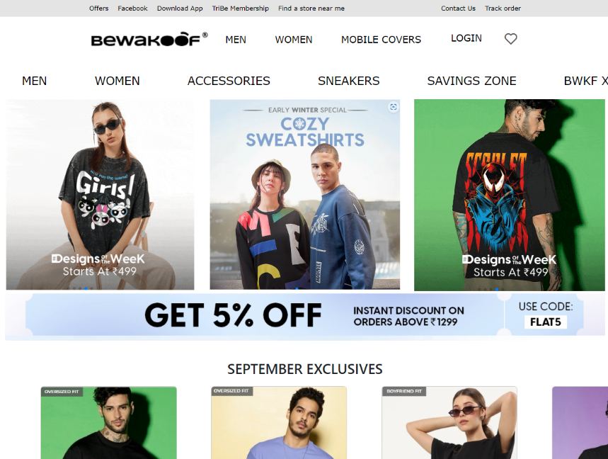
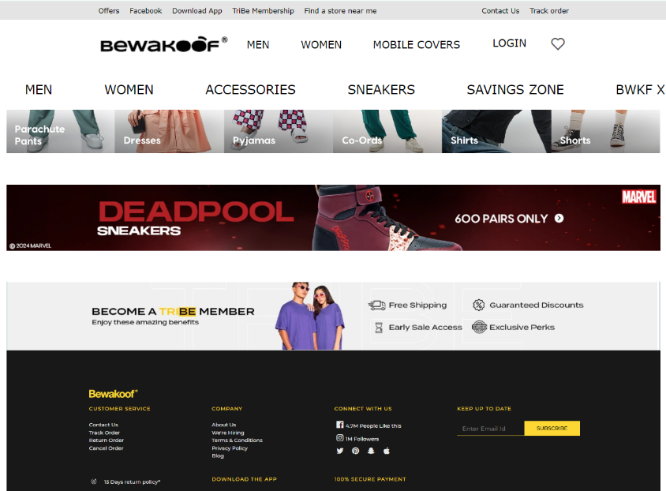
Online Shopping Website
This presentation will explore the development of a user-friendly and feature-rich online shopping website, designed to provide customers with a seamless and enjoyable shopping experience. Discover a world of convenience and incredible deals at your fingertips. Browse our diverse selection of products, enjoy personalized recommendations, and experience seamless shopping from the comfort of your home.

Slide 4
Problem Statement
In today's fast-paced digital world, consumers expect a seamless, convenient, and personalized shopping experience online. However, many existing online shopping platforms face challenges in meeting these expectations due to complex interfaces, limited product selections, inadequate customer support, slow delivery times, and a lack of personalization. These issues can lead to customer frustration, reduced satisfaction, and lower conversion rates. The primary problem is the need for a comprehensive online shopping platform that offers a user-friendly interface, a wide range of high-quality products, personalized recommendations, secure payment methods, and efficient delivery services. The platform must also provide responsive customer support to address any issues that arise during the shopping process. Without these features, customers may experience difficulties in finding and purchasing products, leading to abandoned carts and decreased customer loyalty.

Slide 5
Technical Details
Html5: This project uses the basic html codes to provide structure to our web page and its contents. For example, content structured within a set of paragraphs, an unordered list, articles, navigation links and etc.
CSS: It is used to style and layout our web page, in the areas of altering fonts, changing color, size, background images and spacing the content and its splitting into multiple columns, adding animations and other decorative features.
JavaScript: It is used to create dynamic and interactive web contents like adding new tasks, deleting them, marking them as incomplete and etc.
Bootstrap: Bootstrap is a popular front-end framework used for developing responsive and mobile-first websites quickly and efficiently.
React JS: ReactJS is a popular JavaScript library used for building user interfaces, particularly single-page applications.

Slide 6
Key Features
Minimalist design: Our website has a clean and simple interface that allows you to focus on your tasks without any distractions.
Responsive layout: Our website adapts to different screen sizes and devices, so you can access it from your desktop, laptop, tablet or smartphone.
Dynamic interface: Our website updates your tasks in real-time, so you can see the changes as you make them.
Offline functionality: Our website works even when you are offline, so you can use it without an internet connection.
Data persistence: Our website saves your tasks on your browser’s local storage, so you can access them anytime and anywhere without losing your data.
Advanced Search and Filtering: A robust search engine that allows users to quickly find products by name, brand, or category.
Multilingual and Multi-Currency Support: Support for multiple languages to cater to a global audience.

Slide 7
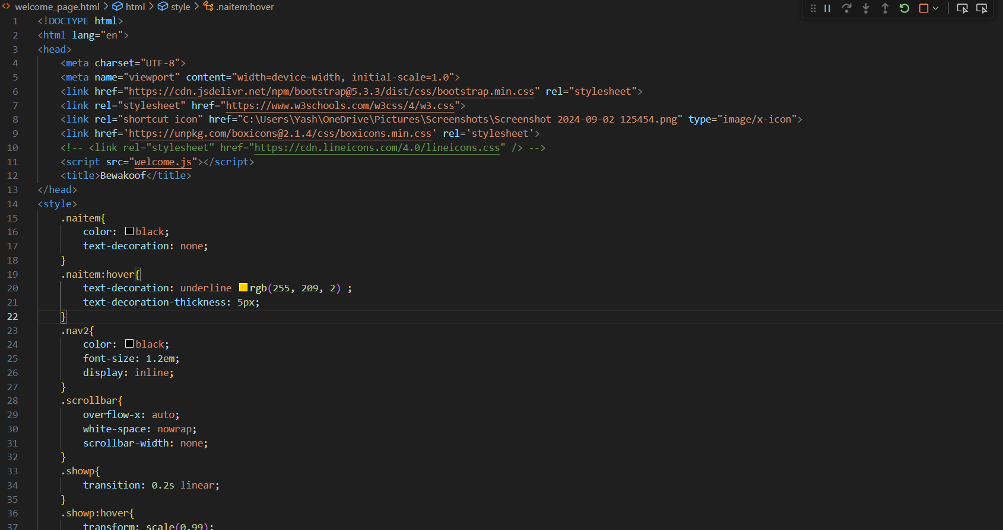
Project Highlights

Slide 8
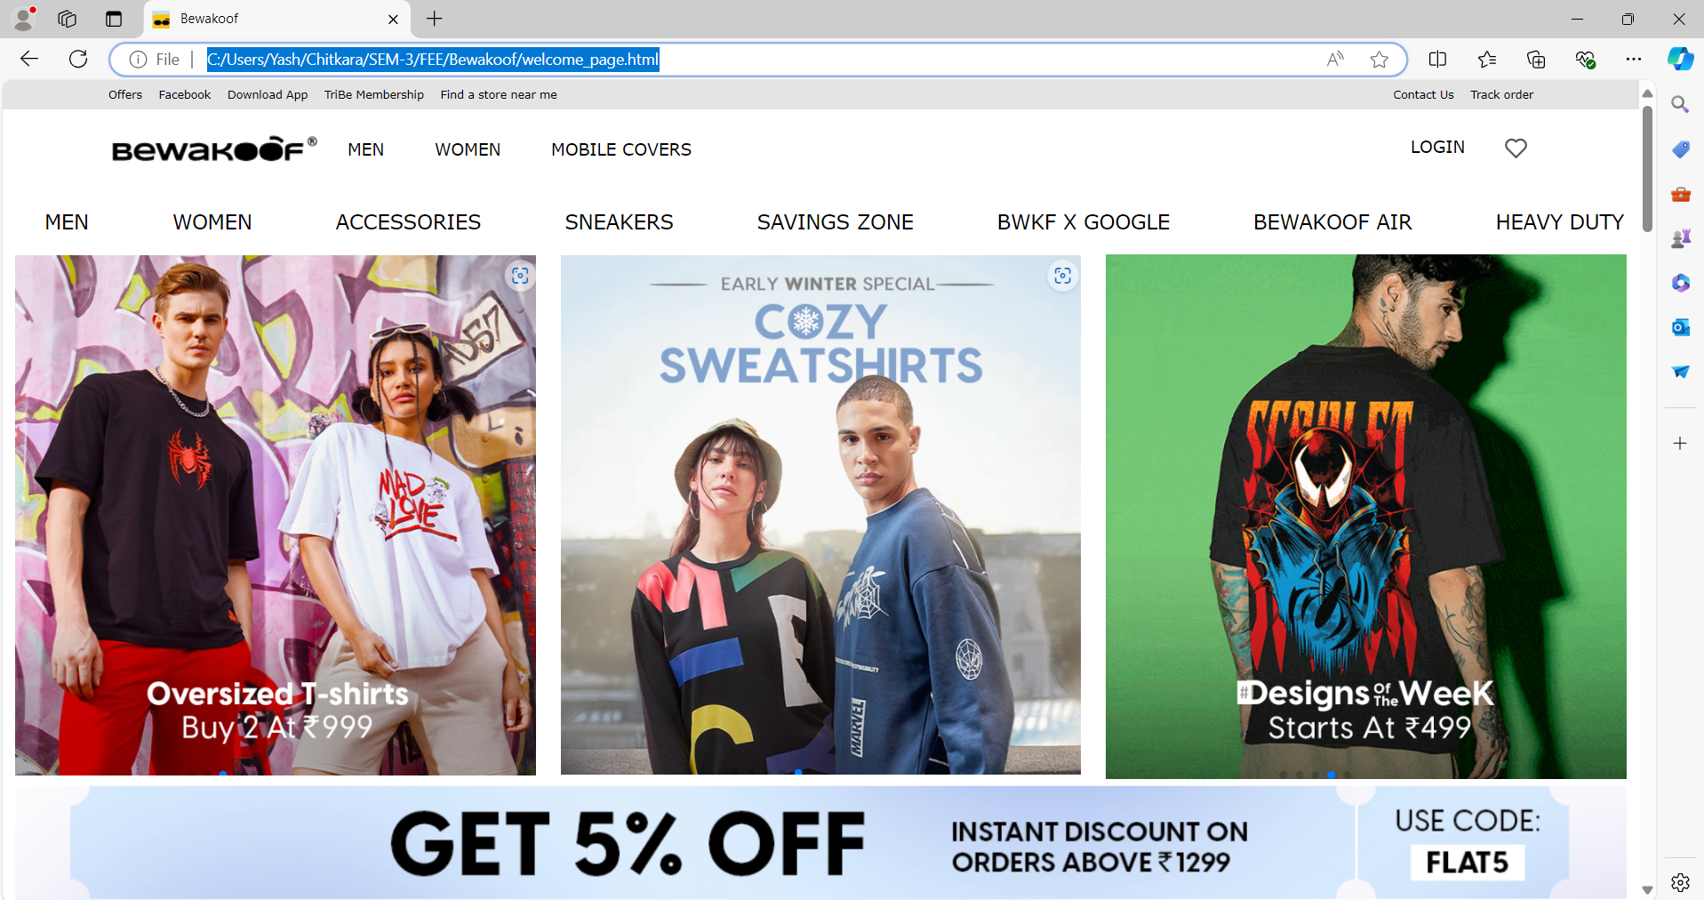

Slide 9
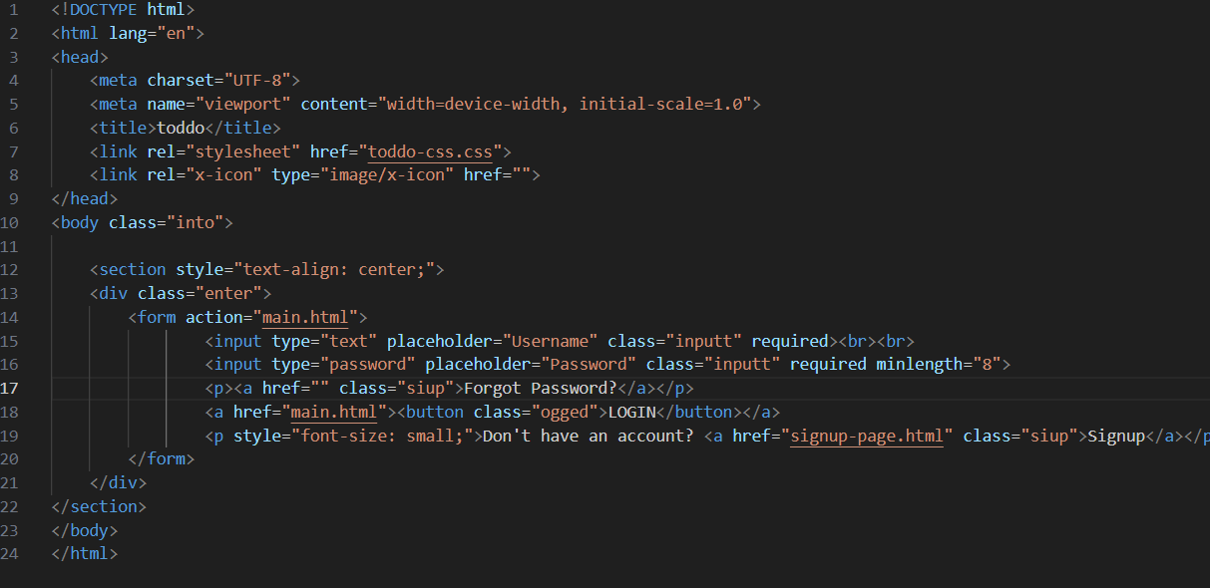

Slide 10
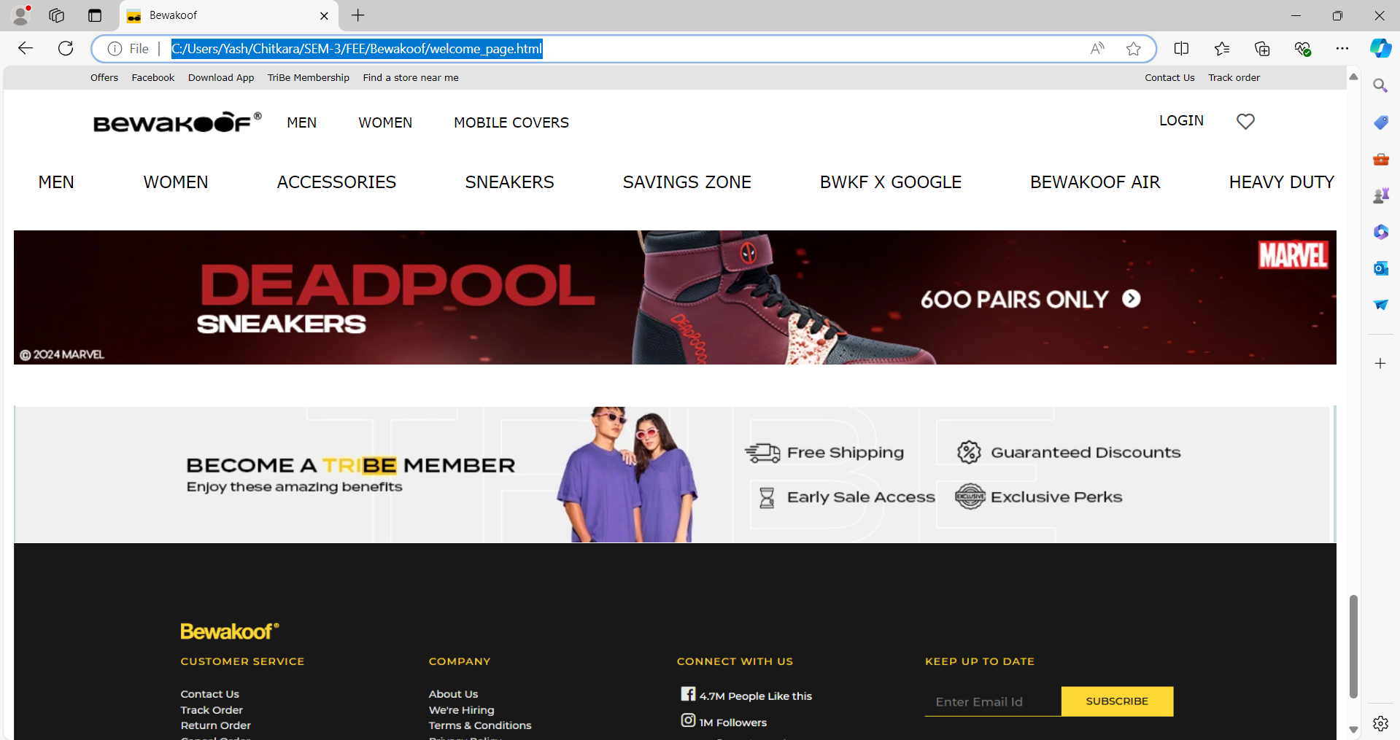

Slide 11
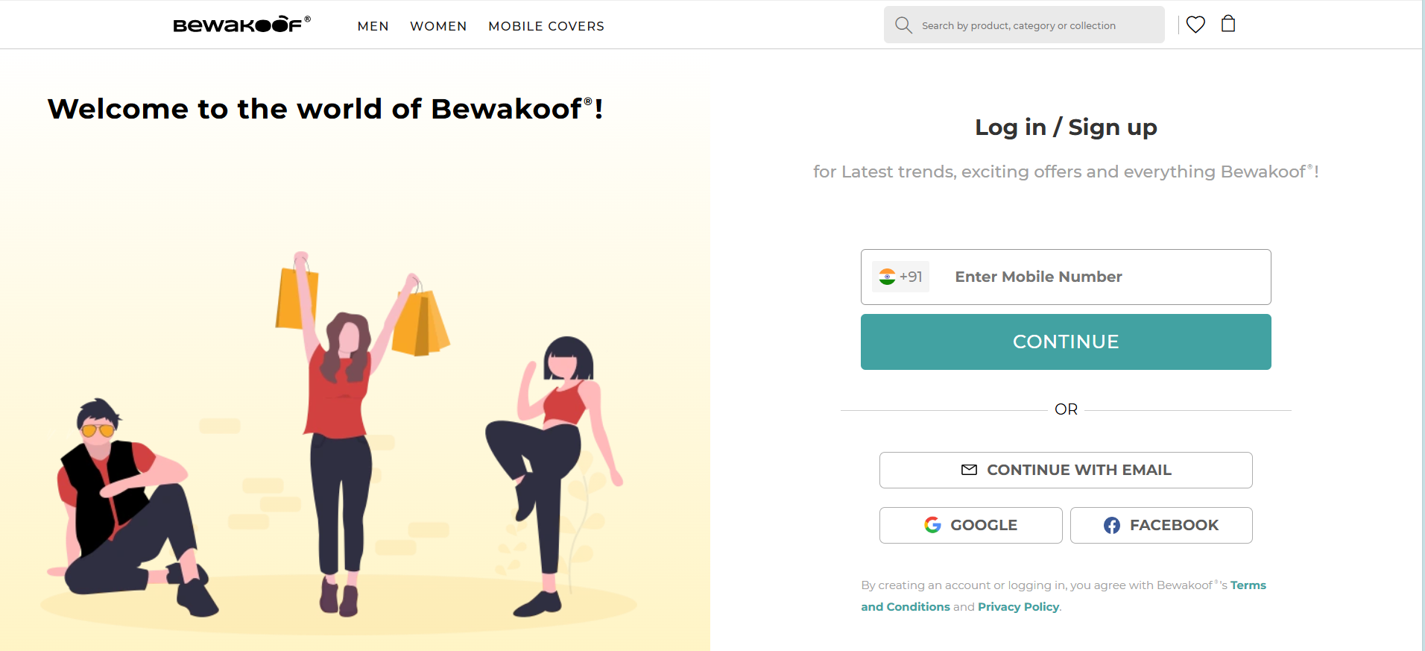

Slide 12
Conclusion
In conclusion, the online shopping website project developed using HTML, CSS, Bootstrap and JavaScript successfully demonstrates how a modern, responsive, and interactive e-commerce platform can be created with core web technologies. Through the use of HTML for structure, CSS for styling, and JavaScript for dynamic functionality, this project showcases a user-friendly interface, efficient navigation, and essential features like product listings, shopping cart management, and responsive design.
This project not only highlights the power of these fundamental technologies in building a functional and aesthetically pleasing website but also lays the groundwork for further enhancements and integration of advanced features. It is a solid foundation for exploring more complex development techniques, such as back-end integration, database connectivity, and full-stack development.
Overall, this project is a testament to the capabilities of HTML, CSS, and JavaScript in creating engaging and functional web applications in the e-commerce space

Slide 13
References
Links:
www.kaprion.one
LOUIS VUITTON - Official India Website
taskspace | beautiful, simple, customizable personal task manager

Slide 14


